Slide 1
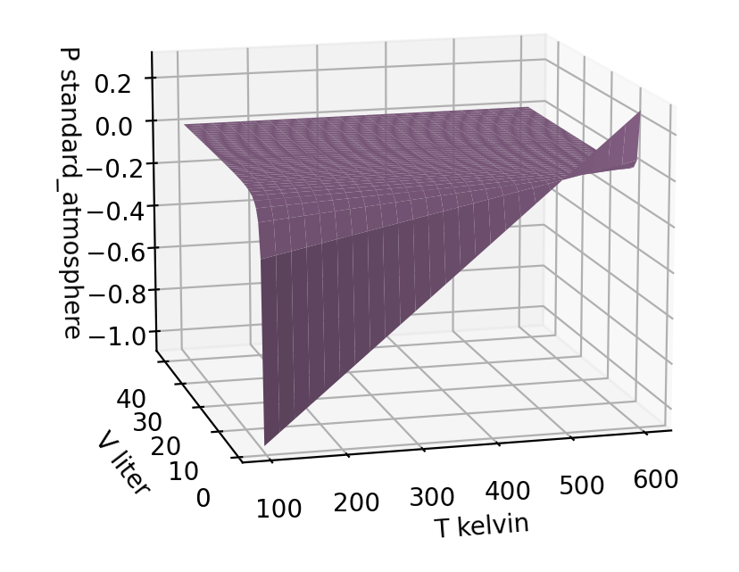
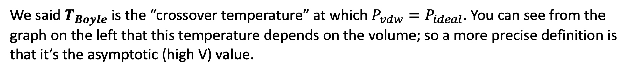
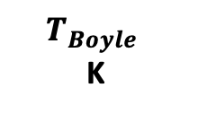
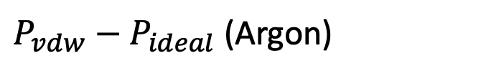
Some comments on the Boyle temperature
We said $T_{Boyle}$ is the “crossover temperature” at which $P_{vdw}=P_{ideal}$. You can see from the graph on the left that this temperature depends on the volume; so a more precise definition is that it’s the asymptotic (high V) value.
$P_{vdw}−P_{ideal}$ (Argon)
a
L²bar/mol²
b
L/mol
$$T_{Boyle}$$
K
Argon | 1.355 | 0.03201
Benzene | 18.24 | 0.1193
Bromobenzene | 28.94 | 0.1539
Butane | 14.66 | 0.1226
509
Carbon dioxide | 3.6 | 0.0427
425
Nitrogen (N₂) | 1.37 | 0.0387
>1000
Oxygen (O₂) | 1.38 | 0.0319
>1000
One take-home is this: When $T<T_{Boyle}$, there are lots of intermolecular attractions, and the pressure of the gas is less than ideal. As you can see, $T_{room}<T_{Boyle}$for most common gases.

Slide 2
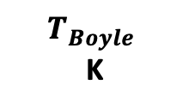
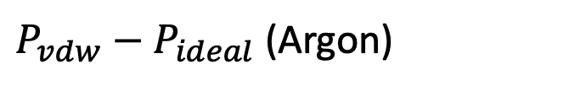
Think-pair-share about your estimation of n in the unknown gases lab
We said $T_{Boyle}$ is the “crossover temperature” at which $P_{vdw}=P_{ideal}$. You can see from the graph on the left that this temperature depends on the volume; so a more precise definition is that it’s the asymptotic (high V) value.
$P_{vdw}−P_{ideal}$ (Argon)
a
L²bar/mol²
b
L/mol
$$T_{Boyle}$$
K
Argon | 1.355 | 0.03201
Benzene | 18.24 | 0.1193
Bromobenzene | 28.94 | 0.1539
Butane | 14.66 | 0.1226
509
Carbon dioxide | 3.6 | 0.0427
425
Nitrogen (N₂) | 1.37 | 0.0387
>1000
Oxygen (O₂) | 1.38 | 0.0319
>1000
In your unknown gases lab, when you predicted $n$ (and therefore the mass of your unknown gas), were you were under-estimating $n$ or over-estimating $n$?

Slide 3
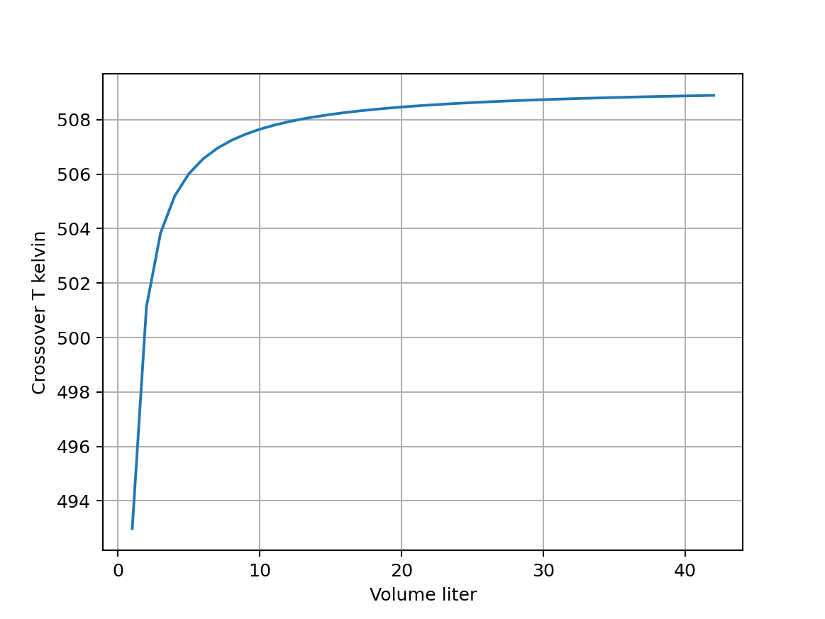
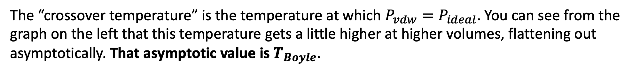

Blackboard challenge: Analytical derivation of the Boyle temperature of a vdw gas
The “crossover temperature” is the temperature at which $P_{vdw}=P_{ideal}$. You can see from the graph on the left that this temperature gets a little higher at higher volumes, flattening out asymptotically. That asymptotic value is $T_{Boyle}$.
$P_{vdw}−P_{ideal}$ (Argon)
$$T_{Boyle}$$
Derive $T_{Boyle}$, the asymptotic (large V) limit of the crossover temperature

